Slide 1
Diversity dynamics in bivalves using Sr_isotope & δ13C as proxies for paleoproductivity as a driver for diversity dynamics changes
Ahmed El Manharawy
27.07.2020

Slide 2
Introduction
Why paleo-diversity dynamics?!
We can use biodiversity changes and its causes in the past in order to predict its changes in response of current environmental parameters changes! (Garland & Ives, 2000) and its changes in response of prospected climate changes in the future! (Cordellier & Pfenninger, 2009).
Why Bivalvia?!
Mollusca are in the second place of most abundant organisms after arthropods. However, most arthropods shells are made of organic materials! (Stanley, 1970).
Bivalvia are the in the second place of most abundant Mollusca after gastropods. However, shells in gastropods are made of aragonite! (Stanley, 1970).

Slide 3
Introduction
In this project, I try to check if there’s a relation between increasing nutrients delivery to marine systems by weathering and diversity dynamic changes?!
( using Sr_isotope as a proxy for nutrients produced by weathering)
Furthermore, I consider primary source for nutrients formed through ocean carbon cycle!
(using δ13C as a proxy for primary productivity).

Slide 4
Previous work
More availability of nutrients enhances marine origination rates! (Cárdenas & Harries, 2010).
Orogeny and mountains building process leads to increase weathering and nutrients delivery to marine systems and more Sr_isotope in marine systems (Veizer 1987). As a consequences of that marine origination rates increase (Kiessling, 2010).

Slide 5
Hence, there’s a relation among origination rates, weathering and Sr_isotope

Slide 6
Hypothesis
High productivity enhances bivalves diversity dynamics!

Slide 7

Materials & Methods

Slide 8
Materials
I downloaded bivavles ( and gastropods) data from PBDB.
I obtained δ13C data from chronosphere.
I used sr_isotpe data provided by prof. Kiessling.

Slide 9
Material (diet of bivalves)
"deposit feeder, suspension feeder“
"deposit feeder"
"suspension feeder"
"chemosymbiotic"
"deposit feeder, chemosymbiotic"
"photosymbiotic"
"carnivore"
"suspension feeder, chemosymbiotic"
"herbivore"
"chemosymbiotic, suspension feeder“
"suspension feeder, photosymbiotic“
"photosymbiotic, suspension feeder"

Slide 10
Material (diet of gastropods)
"suspension feeder"
“carnivore”
“grazer”
"omnivore, grazer"
"detritivore"
"parasite"
"coprophage, deposit feeder"
"coprophage"
"browser, omnivore"
"omnivore"
"grazer, suspension feeder"
"detritivore, suspension feeder"
"parasite, carnivore"
"grazer, browser"

Slide 11
Materials
I considered only categories that related to nutrients either produced by ocean carbon cycle or brought to marine systems by weathering:
Suspension feeders
Deposit feeders

Slide 12
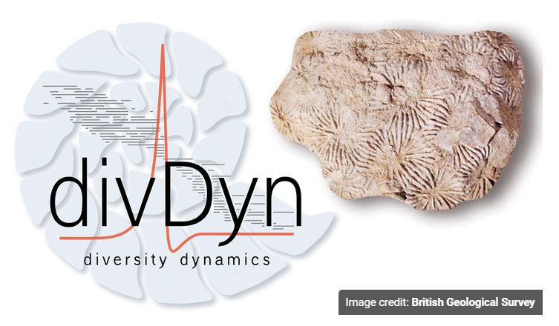
Methods

Slide 13

Package “divDyn”
Processing the data (downloading data)
Number of occurrences downloaded
( Biv.:14,686 & Gast.:19,470 )
Cleaning the data
Binning the data
Number of occurrences after binning the data ( Biv.:13,246 & Gast.:17,275 )
Subsampling the data (Shareholder Quorum Subsampling (SQS))

Slide 14
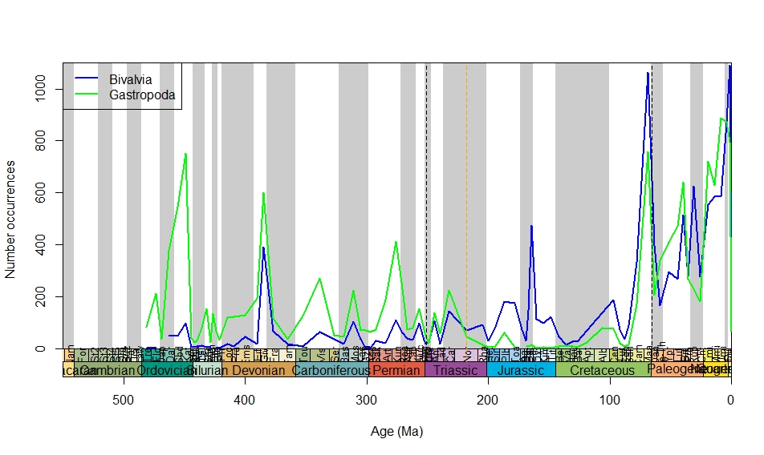

Slide 15
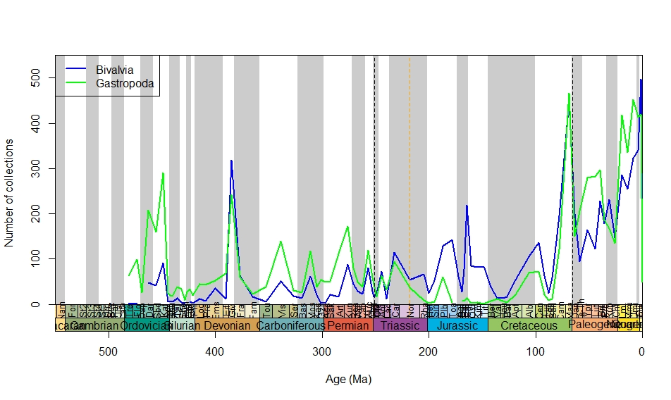

Slide 16
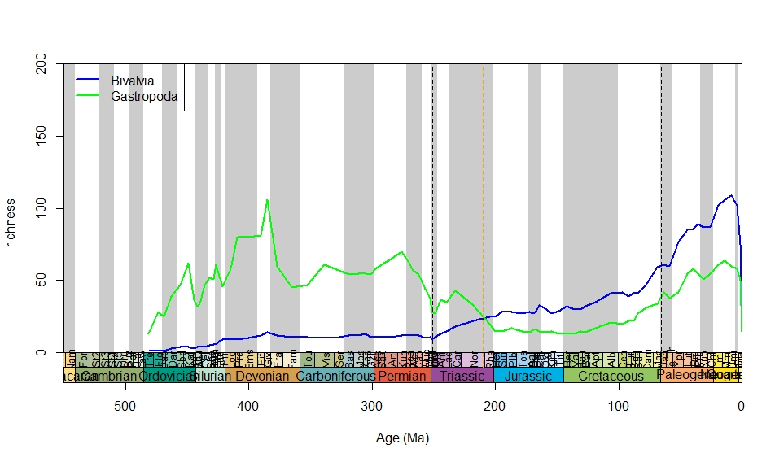

Slide 17
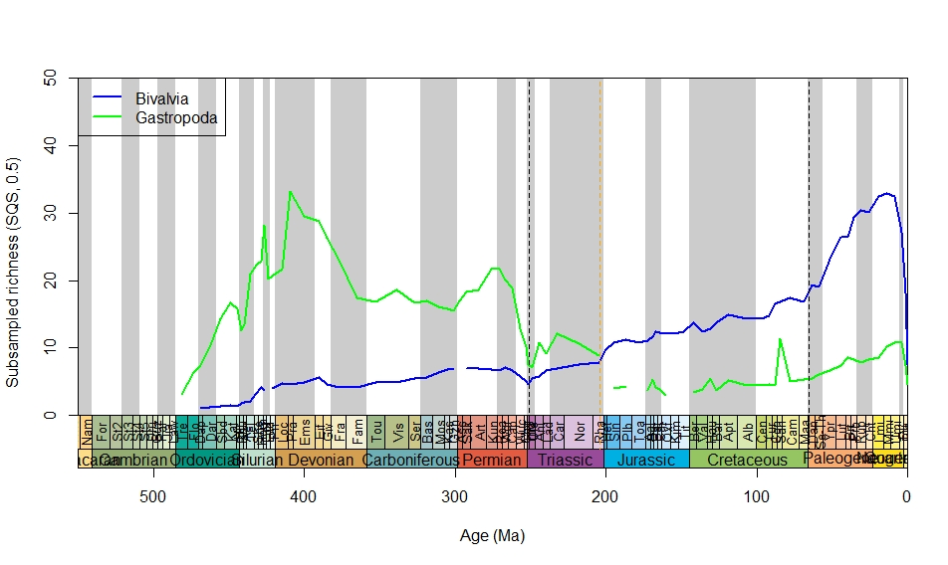

Slide 18
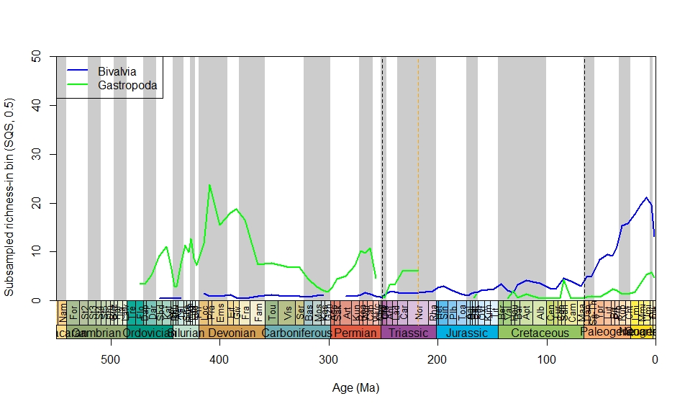

Slide 19
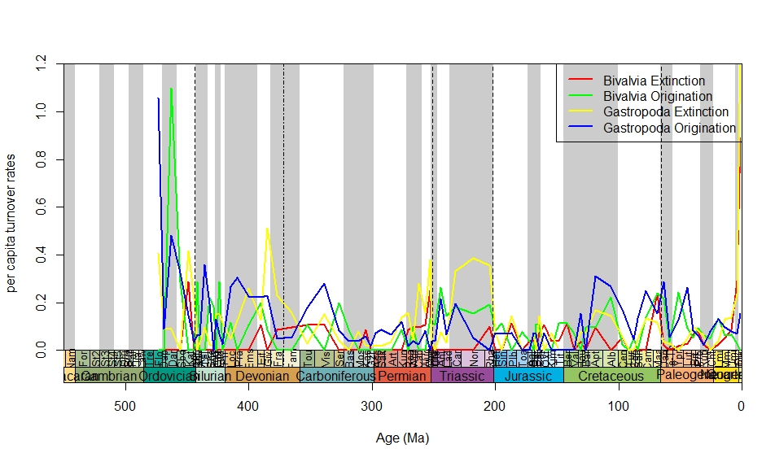

Slide 20
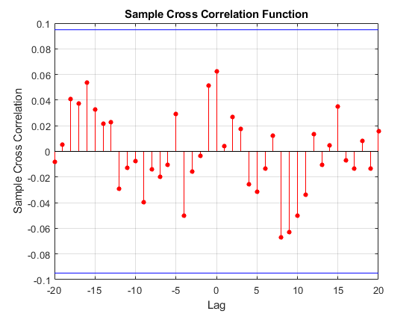
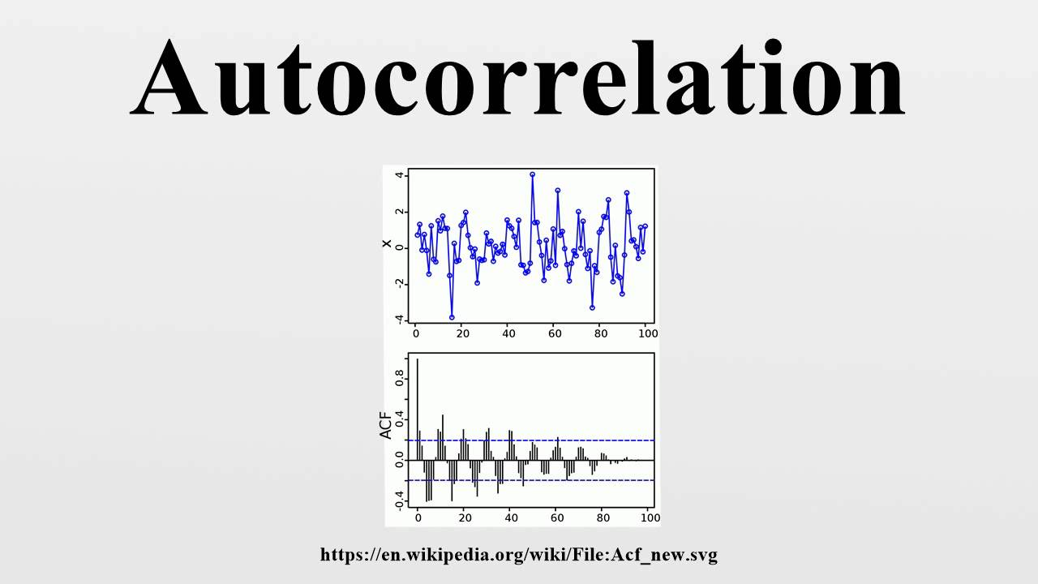
Methods

Slide 21
Cross-correlation
We should run the auto-correlation first to check significant lags!
Then, we can run the cross-correlation to detect either our parameters are directly or reversely proportion to each other!

Slide 22
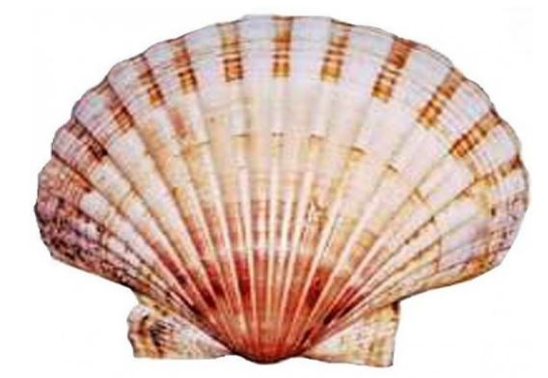
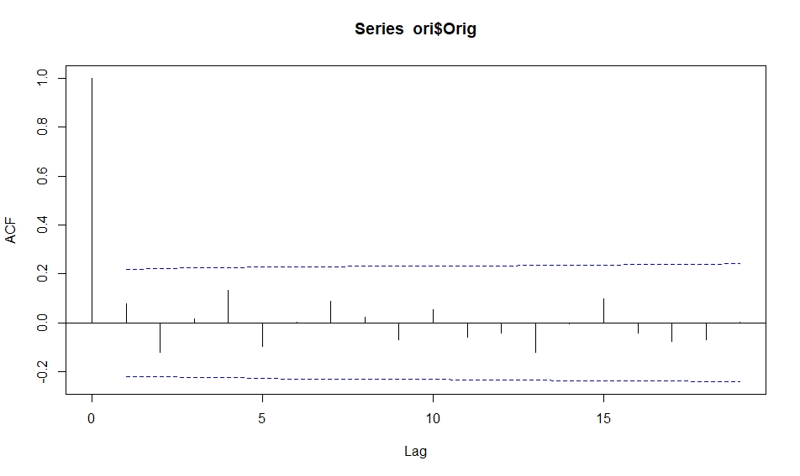
Origination auto-correlation

Slide 23
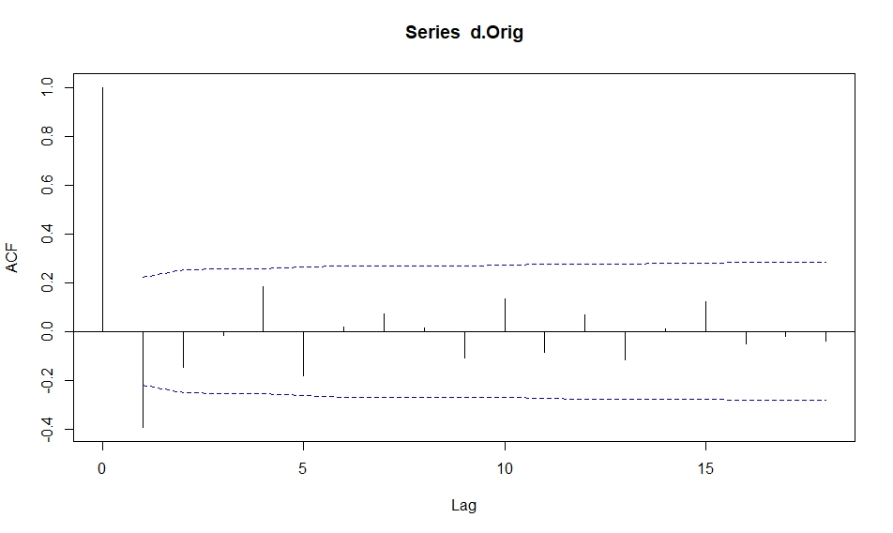
First diff. origination auto-correlation

Slide 24
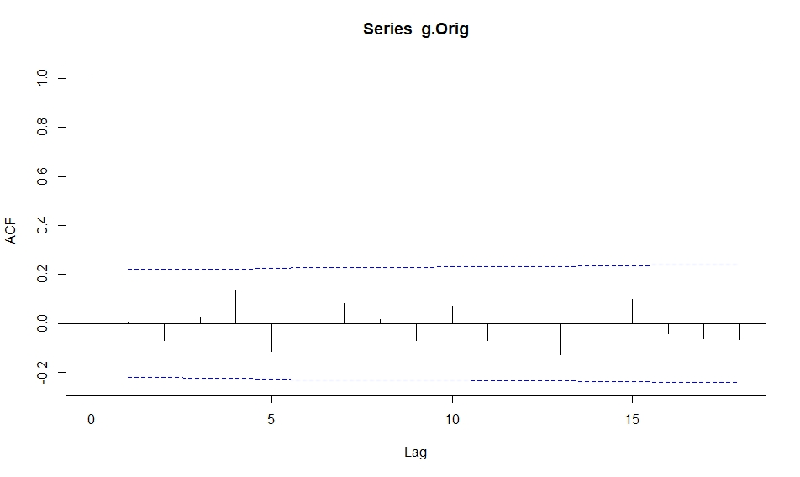
Generalized diff. origination auto-correlation

Slide 25
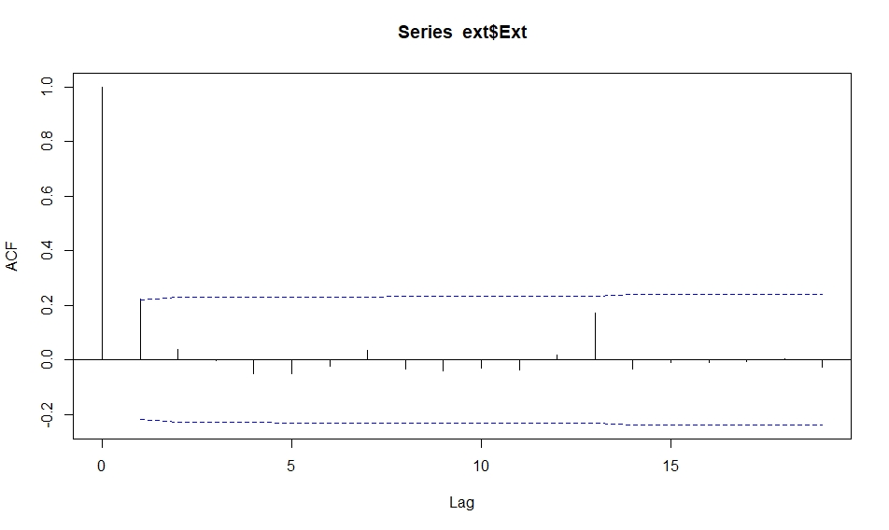
Extinction auto-correlation

Slide 26
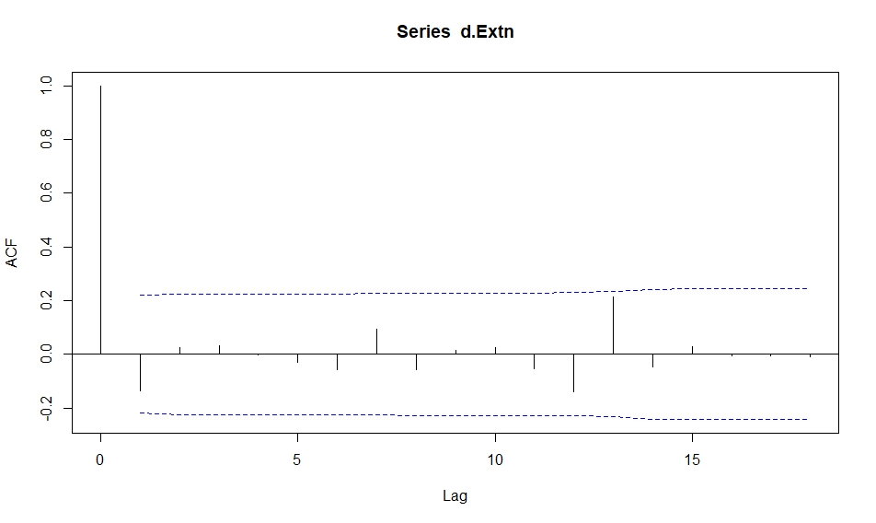
First diff. extinction auto-correlation

Slide 27
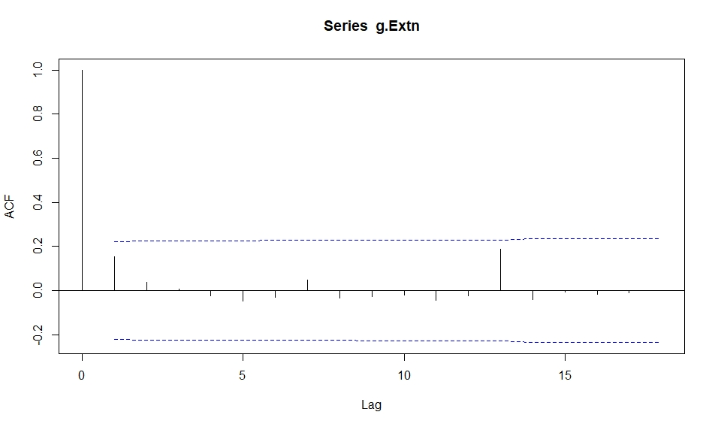
Generalized diff. extinction auto-correlation

Slide 28
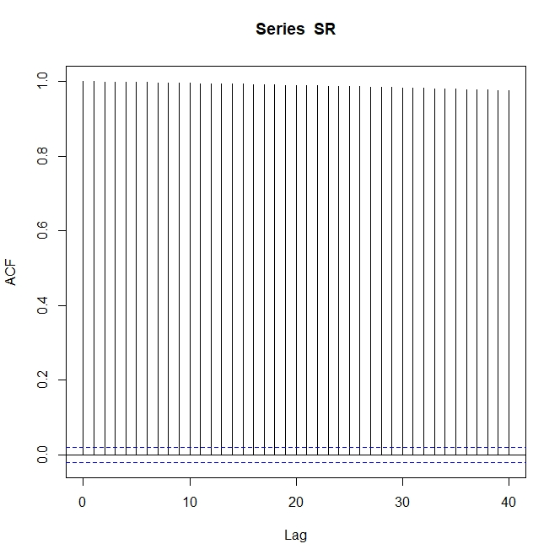
Sr_isotope auto-correlation

Slide 29
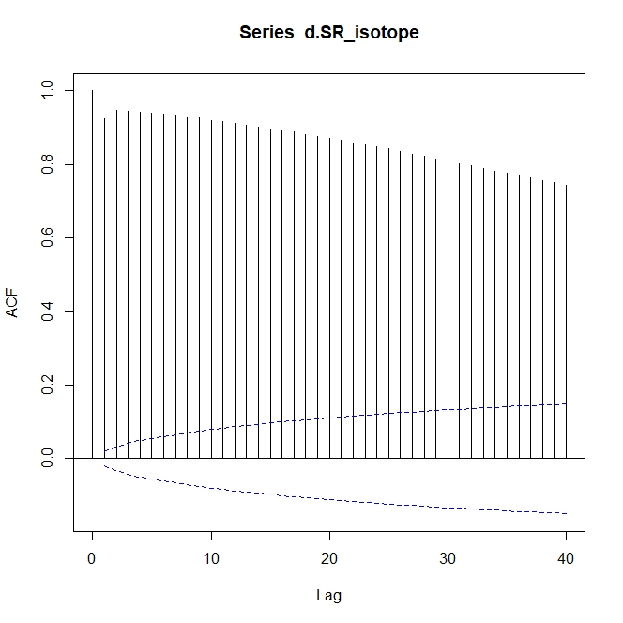
First diff. sr_isotope auto-correlation

Slide 30
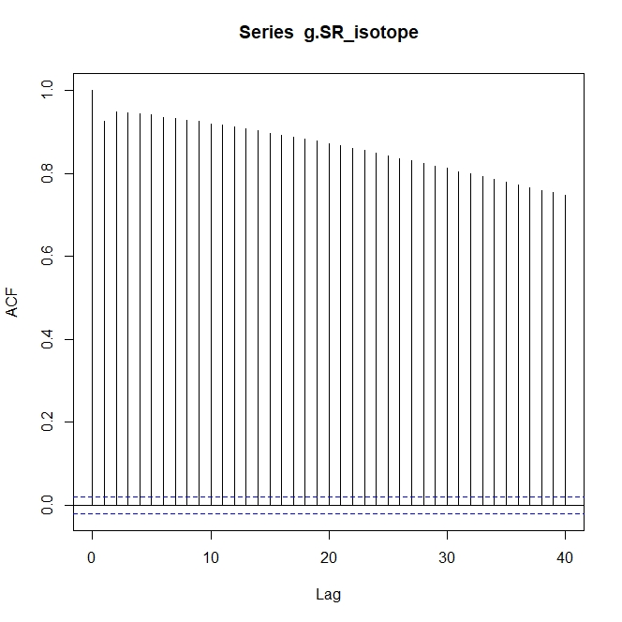
Generalized diff. sr_isotope auto-correlation

Slide 31
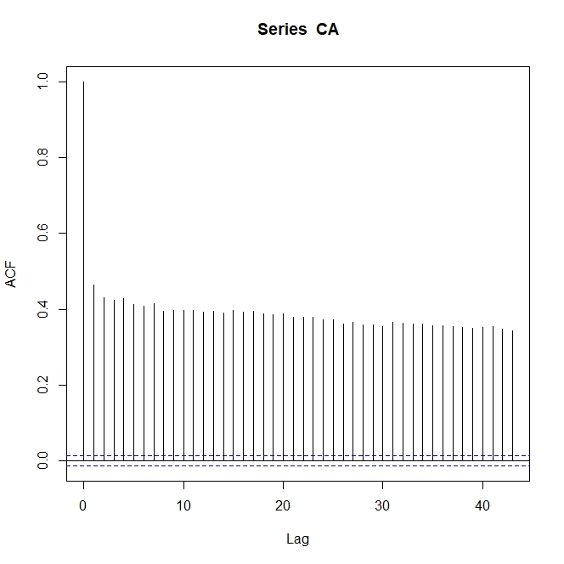
δ13C auto-correlation

Slide 32
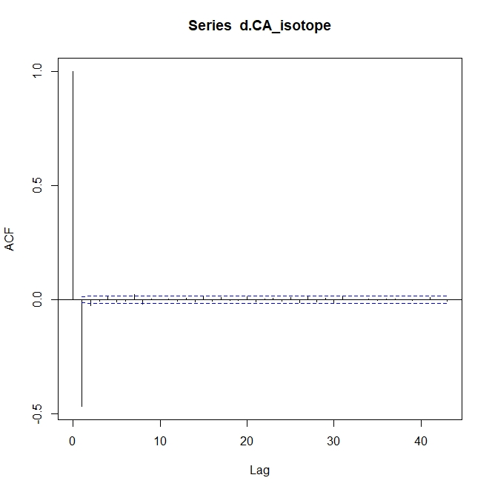
First diff. δ13C auto-correlation

Slide 33
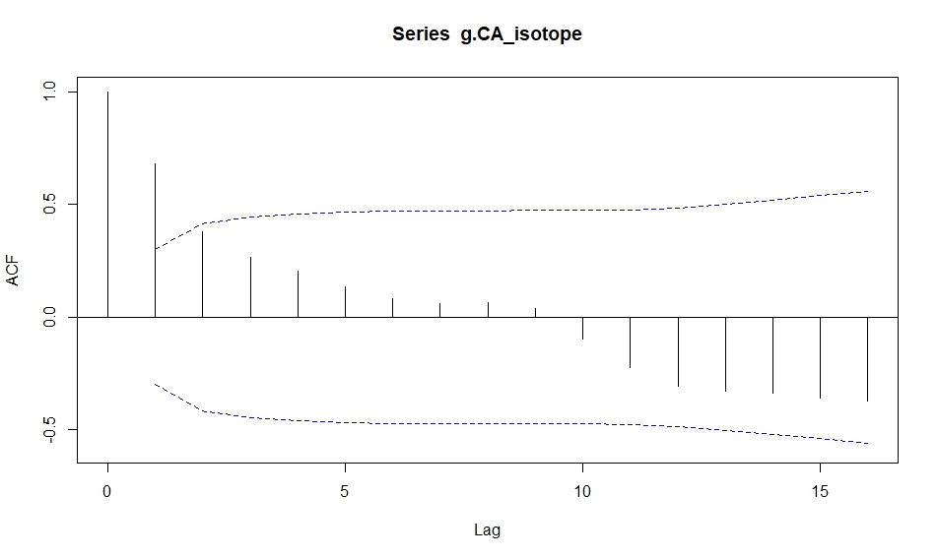
Generalized diff. δ13C auto-correlation

Slide 34
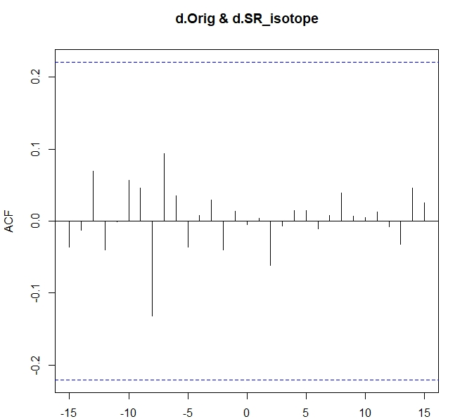
Cross-correlation
(Orig. & sr_isotope)

Slide 35
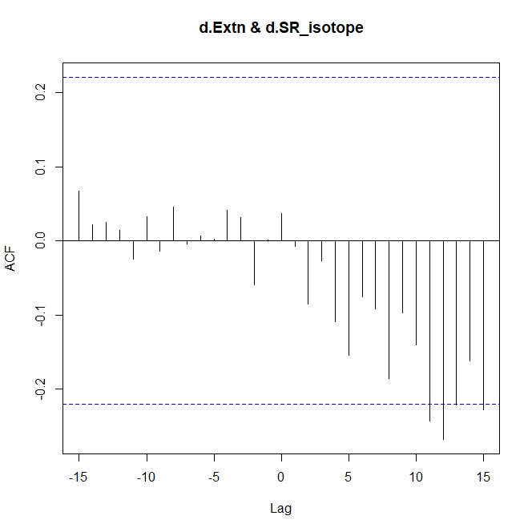
Cross-correlation (Ext. & sr_isotope)

Slide 36
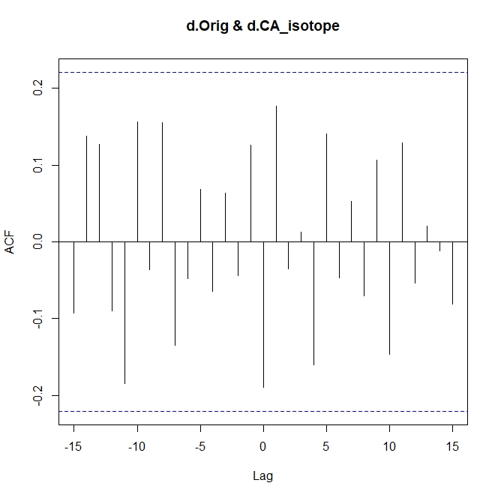
Cross-correlation (Orig. & δ13C)

Slide 37
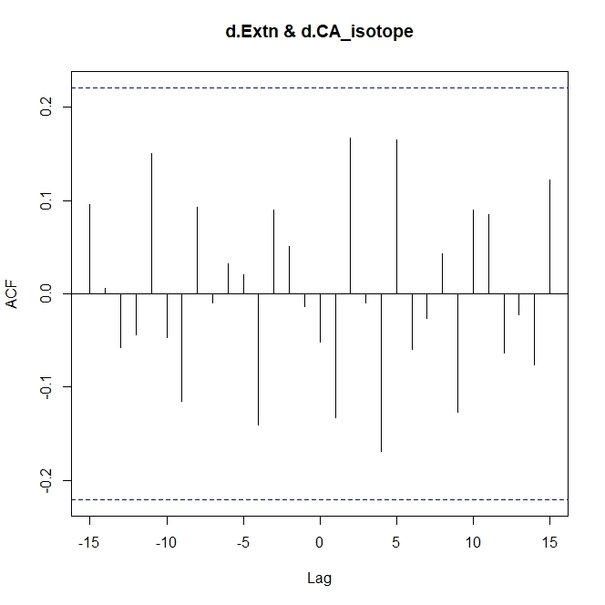
Cross-correlation (Ext. & δ13C)

Slide 38
Objectives
Detection if there is a relation between productivity increase and diversity dynamics changes?!

Slide 39
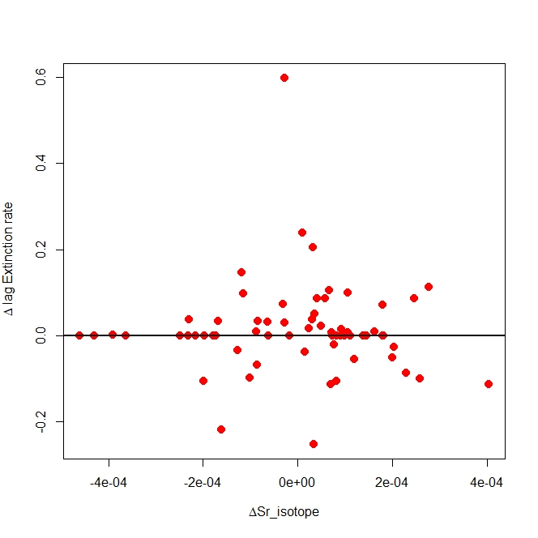
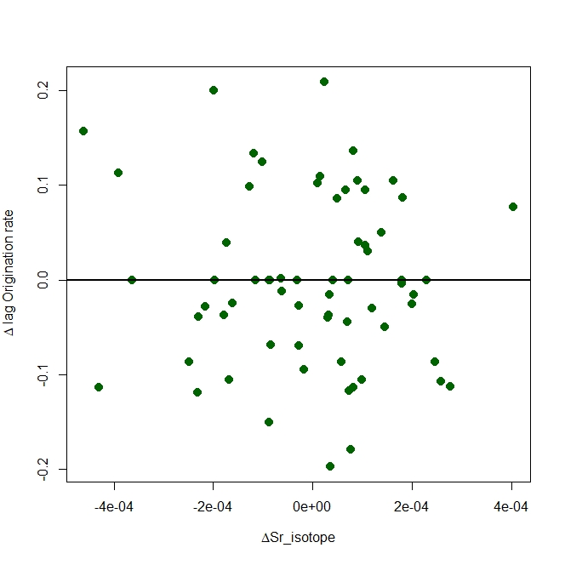

Slide 40
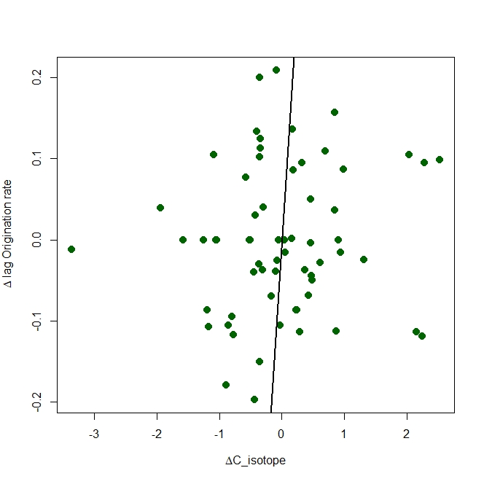
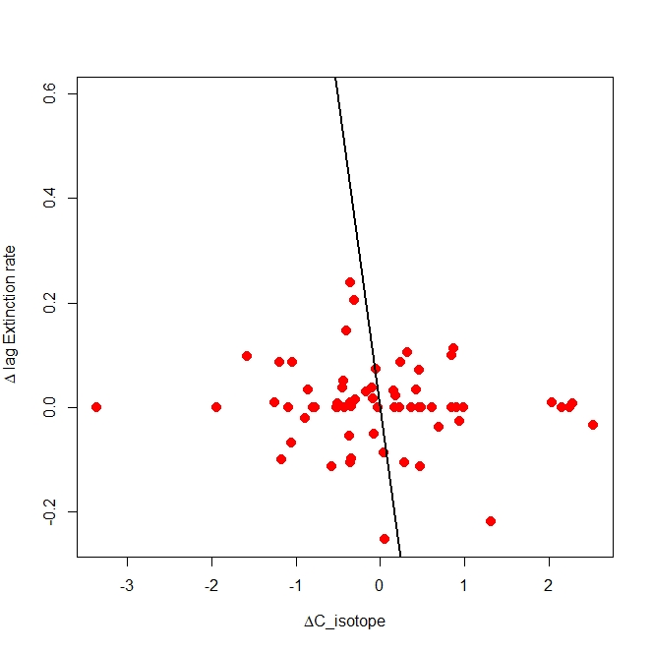

Slide 41
Motivation
Nowadays, warming conditions and ocean acidification dominate so we can assume that (chemical) weathering has to be enhanced! So, we can claim that nutrient delivery should be increased. Furthermore, more inorganic carbon should be increased within ocean carbon cycle, in response of current oceans acidification. Hence, what’s the effects on marine origination rates (biodiversity dynamics)?!

Slide 42
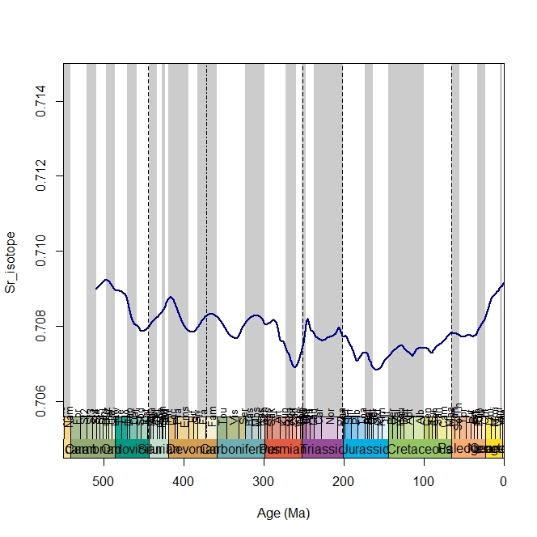
Sr & diversity dynamics

Slide 43
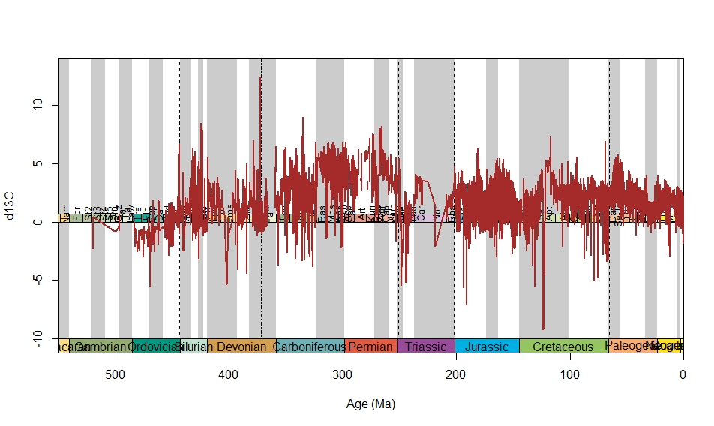
δ13C & diversity dynamics

Slide 44
Conclusion
Nutrients delivered by weathering to marine systems (Sr_isotope) plays a role for increasing marine origination rates and diversity dynamics changes, however, it can not enhance origination rates during anoxic conditions even if it increases!
Although there was high nutrients delivery in Middle Cretaceous and high origination rates in both bivalves and gastropods, there was Variscan orogeny so more nutrients delivery and Sr_isotope in Late Carboniferous but there was no increase in origination rates of both bivalves and gastropods!
In Late Devonian there was high weathering associated with Appallacian orogeny, so high sr_isotope, however, there was no origination because of anoxic conditions that affected both bivalves and gastropods. (Bivalves were less affected because infaunal bivalves can adapt with anoxic conditions).
Primary productivity in Late Devonian (black shale formation) and in PEMT (gas hydrate) associated with no increase in origination rate (this may be because of anoxic conditions dominated)!
Hence, We should consider Oxygen availability in the marine system as an important factor more than productivity increase for diversity dynamics changes!

Slide 45

Thanks

Slide 46
